Slide 1
JIASSO team
Team Members: Ashish Gupta Jimit Bavishi Soheil Tavasoti

Slide 2
Problem statement - 3
Manage room of learners with different experience levels and learning speeds.
Identify learners that are struggling with pace & not comfortable publicly voicing it.
Ease of use for children or those that are newer to technology.

Slide 3
Proposed Solutions using data science
Different Experience Levels
Predicting adults/children that expressed intentions to pursue coding at post-secondary level or work in the technical sector.
Learners Struggling with Pace / Not voicing it?
Predicting adults/children who want to take additional coding/technical learning or coding task at work
Ease of Use
Predicting adults/children/teachers who are likely to recommend CLC to friend, colleague, parent etc. Predicting the teachers who are likely to make donations to CLC

Slide 4
Implementation and scalability
Spark, Scala and Python (Open Source is Cost Effective)
This is the first towards our Big Data solution to scale for large datasets

Slide 5
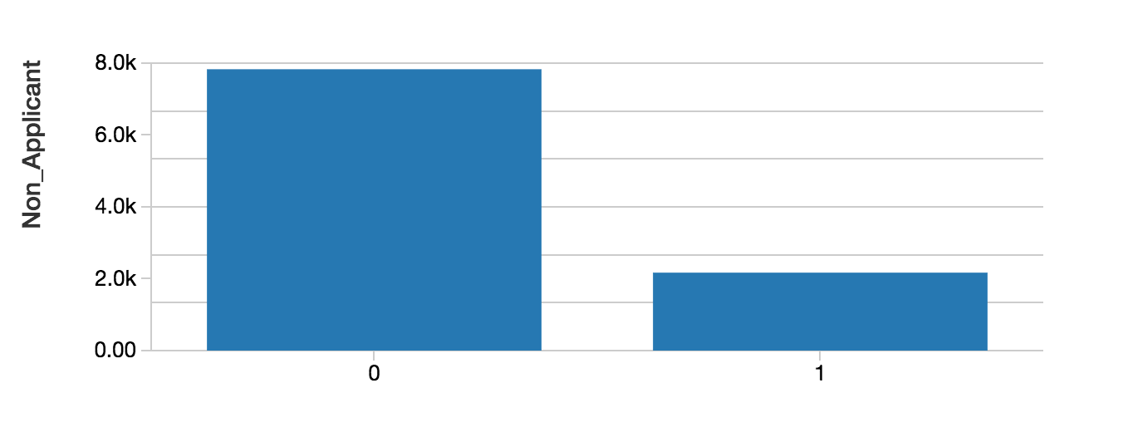
Managing learners with different experience level
Predicting adults/children who want to take additional coding/technical learning or coding task at work
Significance: CLC will be target the audience that require extra attention.
Will Child work in coding, when he/she grows up
Factors Influencing the Significance.
Use coding/tech in my personal life
Take on new coding/tech tasks at work
Updated resume/LinkedIn to include coding/tech skills
Find new job opportunity through the CLC job board
No Yes

Slide 6
Learners Struggling with Pace / Not voicing it?
Predict children that expressed intentions to pursue coding at post-secondary level or work in the technical sector.
Significance: CLC will be better able to reach the audience that require varying degrees of outreach
Will Child work in coding, when he/she grows up
Factors Influencing the Significance.
Kids more confident in coding
Kids want to take coding at college / university
Kids that want to know more about coding
Prior Learning Experience
No Yes

Slide 7
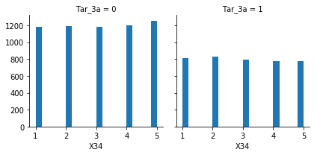
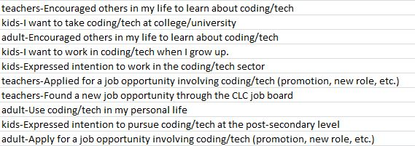
EASE of USE : Recommend to friends
Build classification model to predict if a participant will recommend a CLC event to a friend/colleague
Significance: Recommendations from familiar people proves important to people who are not well-connected to internet
Willingness to study Tech at College
Factors Influencing the Significance.
Yes No

Slide 8
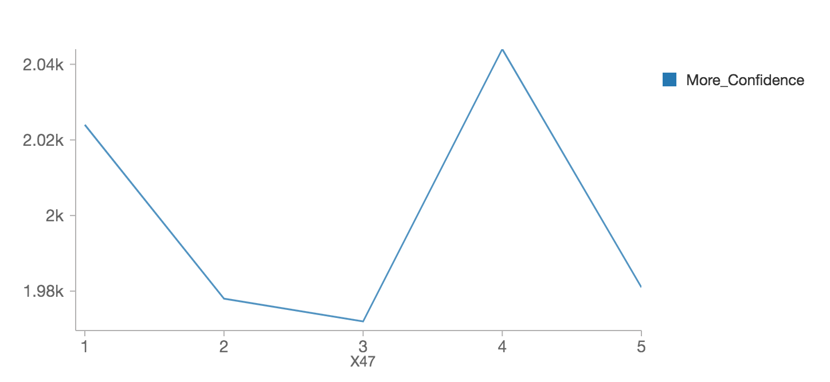
promoting ease of use HELPS CLC with DONATIONS
Predicting the teachers who are likely to make donations to CLC
Significance: Demonstrate the faith established in teaching community for CLC’s practices
Features Influencing the Significance
teachers-Use(d) coding/tech in my personal life
teachers-Were more confident in my use of coding/tech
teachers-Engaged in additional coding/tech learning
teachers-Found job opportunity through the CLC job board
teachers-Found job opportunity through a new CLC connection.
Prior Experience with CLC Program
More Confidence
Likely to make a donation

